Slide 1
Creating Effective Newsletters
Presented by: Ann Gipalo
Duval County Council PTA
September 7, 2012
Notes:
This template can be used as a starter file for presenting training materials in a group setting.
Sections
Right-click on a slide to add sections. Sections can help to organize your slides or facilitate collaboration between multiple authors.
Notes
Use the Notes section for delivery notes or to provide additional details for the audience. View these notes in Presentation View during your presentation.
Keep in mind the font size (important for accessibility, visibility, videotaping, and online production)
Coordinated colors
Pay particular attention to the graphs, charts, and text boxes.
Consider that attendees will print in black and white or grayscale. Run a test print to make sure your colors work when printed in pure black and white and grayscale.
Graphics, tables, and graphs
Keep it simple: If possible, use consistent, non-distracting styles and colors.
Label all graphs and tables.

Slide 2
Where to get Newsletter Templates:
Microsoft Word:
Click the Microsoft Office Button , and then click New.
Under Templates, do one of the following:
Click Installed Templates to select a template that is available on your computer.
Click one of the links under Microsoft Office Online, such as Flyers or Letters and Letterhead.
Double-click the template that you want.
Notes:
Give a brief overview of the presentation. Describe the major focus of the presentation and why it is important.
Introduce each of the major topics.
To provide a road map for the audience, you can repeat this Overview slide throughout the presentation, highlighting the particular topic you will discuss next.

Slide 3
Microsoft Publisher:
I highly recommend this program!!
From your Start button, open Publisher
1st page will have samples of available Popular Templates
Search database of installed templates or search online templates.
Notes:
This is another option for an Overview slides using transitions.

Slide 4
Minimum standard newsletter elements:
Nameplate – Banner at top of newsletter with the name of your newsletter, logo/mascot, and:
a. Date, Volume and issue information
b. Name of Principal and PTA President
Masthead: How frequently the newsletter is published, who to contact about anything they read in the newsletter.
a. Recommend only publishing the PTA President’s home phone number.
b. Editor’s e-mail address.

Slide 6
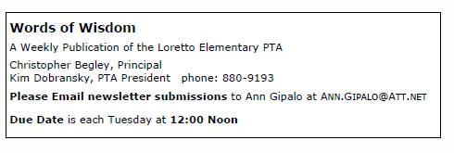

Slide 7
Other Common Elements
Calendar
Board Members List: Name, position and phone number or e-mail address.
Table of Contents.
Frequent Contacts: PTA website address(es), school website, OnCourse, MyLunchMoney.com, etc.
Notes:
Use a section header for each of the topics, so there is a clear transition to the audience.

Slide 8
Calendar Items
August: Check the School’s Master Calendar
Create a calendar list with ALL school events
Weekly newsletters: Include upcoming events for next 10 days to 3 weeks.

Slide 9
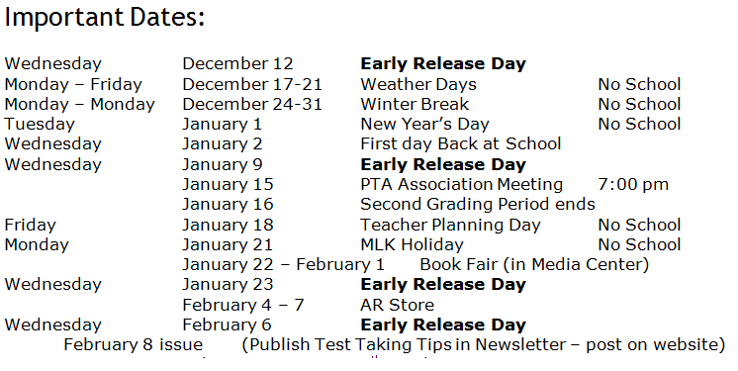

Slide 10
Publishing Schedule:
Normal schedule should be in the masthead in every issue.
If you need to change the schedule for some reason – notify your readers and contributors as soon as possible.
Provide new copy deadline date to contributors.
Notes:
Use a section header for each of the topics, so there is a clear transition to the audience.

Slide 11
How do I fill all that white space??
Use your Board meeting notes and the master calendar to prompt you to contact other Board members who have news/events they need to publicize.
Contact other Board members at least a week before you need their article. Follow up in 2-3 days.
Notes:
Use a section header for each of the topics, so there is a clear transition to the audience.

Slide 12
Student Names:
Do NOT publish first and last names of students without signed parent release.
With principal's permission, you may publish first names only in text of newsletter; do not use in photo captions.
Notes:
This is another option for an Overview slides using transitions.

Slide 13
School and PTA items:
Volunteer Requests
2. How to get a DCPS Volunteer Card
3. Volunteer of the Month
4. Accomplishments of teachers and students –
a. newly Board certified teachers
b. top AR Readers
c. Spelling Bee winner
d. Sunshine Math winners, etc.
PTA General Meetings, date and time; then follow up with summary of meeting.

Slide 14
School and PTA items
(continued)
6. PTA Election Info
7. SAC Members, election info, meeting dates and times.
8. Business and Community Members
** Do NOT publish your budget.

Slide 15
Other items to consider:
Supervisor of Elections website
Jacksonville Public Library, Spring Book Sale
Boy Scout and Girl Scout Roundup
Food Bank – items needed
Local Church “Free Sale” dates

Slide 16
Approvals
Every issue of your Newsletter MUST be reviewed and approved by your PTA President and the Principal (or their designee) before it is published.
Notes:
This is another option for an Overview slides using transitions.

Slide 17
Publishing Schedule: Publishing schedule should be included in the _______ box. If you need to change the publishing schedule, let your readers know as far in advance as possible. notify your contributors of any change in copy deadline.
Archive
Keep one clean, printed copy of every issue in a 3-ring binder.
This is the permanent record of what you did.
Notes:
Use a section header for each of the topics, so there is a clear transition to the audience.

Slide 18
Hints and Tips
Ask your Community and Business partners to send you a scalable, .jpg copy of their logo.
Keep a “Working Copy” file in Word
Who, What, Where, When, Why
Edit, Edit, Edit, proofread, 2nd set of eyes, “rest” for 1 day, then proof again.
SPELL CHECK SPELL CHECK SPELL CHECK
Notes:
Summarize presentation content by restating the important points from the lessons.
What do you want the audience to remember when they leave your presentation?
Save your presentation to a video for easy distribution (To create a video, click the File tab, and then click Share. Under File Types, click Create a Video.)

Slide 19
How to clip logos from websites
Go to the company’s website and look for one of their logos.
Microsoft “Snipping Tool” http://windows.microsoft.com/en-us/windows7/products/features/snipping-tool
You can use Snipping Tool to capture a screen shot, or snip, of any object on your screen, and then annotate, save, or share the image.
Snipping Tool is available only in the Home Premium, Professional, Ultimate, and Enterprise editions of Windows 7. Apparently XP and Vista folks are out of luck…
Notes:
Summarize presentation content by restating the important points from the lessons.
What do you want the audience to remember when they leave your presentation?
Save your presentation to a video for easy distribution (To create a video, click the File tab, and then click Share. Under File Types, click Create a Video.)

Slide 20
Electronic Communications:
E-mail your newsletter to parents as a PDF file.
Post on your PTA website and/or the school’s website.
Constant Contact – (DCCPTA monthly “Highlights”). Artwork limitations without upgrade.
Notes:
Summarize presentation content by restating the important points from the lessons.
What do you want the audience to remember when they leave your presentation?
Save your presentation to a video for easy distribution (To create a video, click the File tab, and then click Share. Under File Types, click Create a Video.)

Slide 21
Summary
Communication is what’s important – not the format
Remember your audience – what’s important to them
Inform/Educate your school community about budget and School Board issues, pending legislation at the state and federal levels.
Edit Edit Edit
Notes:
Summarize presentation content by restating the important points from the lessons.
What do you want the audience to remember when they leave your presentation?
Save your presentation to a video for easy distribution (To create a video, click the File tab, and then click Share. Under File Types, click Create a Video.)

Slide 22
Resources
This presentation and other workshop materials www.dccpta.org
Constant Contact www.constantcontact.com
Ann Gipalo Ann.Gipalo@att.net

Slide 23
Congratulations! Good luck!

Slide 24
Questions?

