Slide 1
Your Executive Board: Playing by the Rules
DCCPTA Fall Leadership Workshop September 27, 2014
Mandi Welch and Victor Melone

Slide 2
What will be your greatest challenge this upcoming year?
"Education is the ability to listen to almost anything without losing your temper or self-confidence. " Robert Frost

Slide 3
PTA Purpose
To promote the welfare of children and youth in home, school, community, and place of worship
To raise the standards of home life.
To secure adequate laws for the care and protection of children and youth.
To build close relationships between home and school so that parents and teachers may cooperate in the education of children and youth.
To develop united efforts between educators and the general public to secure for all children and youth the highest advantages in physical, mental, social, and spiritual education.

Slide 4
TODAY –
Planning -- calendar development and goal setting
Maximizing your meetings
Volunteers
Bylaws and standing rules
Role of the secretary
Resources

Slide 5
Key term:
The executive board –
officers of the association,
the chairs of standing committees,
principal or a rep appointed by him/her,
one student, if PTSA (at least 1)
NOTE: The chair of each standing committee shall be selected by the officers of the association.

Slide 6
Early Planning
Hold a post-election orientation. Make sure all board members know their legal and ethical responsibilities and that each member has a job description, Page 1 of the Procedure Notebook.
Set goals for programs, volunteers, membership and ways and means [or whatever matches the VPs];
Develop calendar including 3 (minimum) General meetings

Slide 7
Setting Goals
Assess the needs of your school community by communicating with the principal and teachers. Conduct a survey of all parents to find out what they want and need, as well as who they are.
Develop objectives for actions based on the results of your needs assessment.
Propose your plan for meeting the objectives at a board meeting. Vote on the adoption of the plan and incorporate your PTA’s goals into your annual calendar.
Create budget and a plan to raise funds to support your plan of work and achieve your goals.

Slide 8
Calendar Development
Get the dates from your school for important standing events – registration, Open House, DCPS dates
Schedule 3 General Meetings for budget approval, electing the nominating committee and electing officers
Schedule board meetings at the convenience of the board members
Enter important PTA dates – fundraisers, family nights, Founder’s Day, Take Your Family to School Week and Teacher Appreciation, others

Slide 9
Maximize your Meetings
Best time and location
Agenda building – unfinished business - check minutes; motions: committee should come prepared with motion, no second required – then discussion
Circulate e-documents 3 days prior to meeting: agenda, minutes, treasurer’s report and bank statement

Slide 10
Parliamentary Procedure -- a set of rules for conduction an organized meeting
Considers one item at a time
Extends courtesy to all and partiality to none
Decisions made by a majority vote
Allows the minority opinion to speak
Source - http://www.pta.org/members/content.cfm?ItemNumber=3090
e-learning library Parliamentary Procedure

Slide 11
Volunteers – Why?
Important Benefits
Parents are more involved with their children’s education.
Parents are more informed about the school’s activities.
Volunteer hours may qualify PTA and school for award recognition.
Students, teachers, staff, school, and community success.

Slide 12
Volunteers – How?
Define needs – when and how many
Recruit, recognize and promote
Communicate often – Ex: my-pta.org
Boards grow stronger when they consistently recruit new members and leaders.

Slide 13
Volunteer Screening
Become a volunteer in three easy steps:
Go to http://www.duvalschools.org/ then to the
“Community” TAB then to “Volunteer Information”. Click on the online volunteer application link.
Please allow a two week turn-around for processing.

Slide 14
Bylaws – govern entire membership
Must be current – 3 years from stamped approval date
If expired – not eligible for awards
Procedure for review/renewal
Committee reviews:
Articles with ** must not be changed.
If no changes are recommended fill out current form, notify membership, and send two copies for approval
If changes are recommended, take to board and then to membership after 30 days notice. Send for approval.
Be sure to fill out affirmation box on top left corner of first page.

Slide 15
Where to find Bylaws forms…
Bylaws forms can be found on the state website: www.floridapta.org
Or from Betty Marty bylaws@dccpta.org
Post approved Bylaws on your website

Slide 16
Developing Standing Rules: to guide the work of officers
Form a committee, of at least three people.
Develop the rules (never in conflict with your Bylaws) - using the Bylaws as an outline, with meeting minutes as resource material
Present to the board for approval by a majority vote.
Upon approval, make sure each board member has a copy.
Do not post to website unless in a Board only section

Slide 17
Secretary
Keeps an accurate record of the proceedings of association meetings. These records are the permanent history of the PTA. The secretary should be committed to helping the president conduct a businesslike meeting.
Records minutes of PTA meetings, with special attention given to motions (recorded exactly as stated) and action taken.
Keeps secure official, permanent PTA records, including all originals of approved minutes
Maintains a copy of current bylaws and standing rules, as well as the membership list

Slide 18
Secretary brings to all meetings:
Minutes of the previous meeting
Copies of the previous treasurer’s report
List of unfinished business to be discussed
Agenda
Current bylaws and standing rules
Current membership list
List of committee chairs
Materials for note/minute taking

Slide 19
What Media are O.K. to Take the Minutes?
ON PAPER: Your choice – spiral notebook or composition notebook.
However, ONLY the final* typewritten, approved minutes of the meeting should be kept in your 3-ring binder as the permanent record of your PTA.
*If changes to the minutes are made at later meetings – those changes must be made as instructed on slide 26.
Handwritten notes are no longer retained and are not part of the final association records.

Slide 20
What Media are O.K. to Take the Minutes?
ELECTRONICALLY: On a laptop or tablet computer.
However: We recommend using a digital voice recorder* as a backup. You must obtain the permission of all members present at an Executive Committee or a Board meeting before recording; but recording a General meeting of your association does NOT require approval from the members to record.
* But then you may want to consider taking written notes as a backup to the voice recorder – in case you forget to turn it on…
At the end of the year, create a digital copy of all of the minutes from all of the meetings held that year. Keep the digital copy in the Recording Secretary’s 3-ring binder procedure book.

Slide 21
Approval of Minutes:
Read the minutes of any previous meeting when called upon to do so.
Email: Copies of the association minutes may be Emailed to each member in advance to expedite approval at a board meeting.
Newsletter: Association minutes may be published in the PTA/PTSA newsletter. If your local unit’s newsletter is created/distributed by the school, only a summary of PTA Association actions is printed.
Prior Review: With approval of the association, the minutes can be approved without reading them before the assembly if everyone has had a chance to review them in advance.

Slide 22
Prompt action!
Prepare the minutes and email a draft copy to the president for approval as soon as possible after each meeting.
It is easier if you begin the next day or the same day.
Complete them within 7 or 8 days. This is a reasonable amount of time.
When the President approves the minutes you can email the draft to the other board members for proofreading.

Slide 23
What belongs in a set of minutes: Keep minutes brief and to the point. Minutes contain a record of what the group did, with action recorded in the order it took place. Do not record opinion and discussion. Do record:
Type of meeting (regular, general, executive, special, annual).
Name of the association.
Date, time and place of meeting.
List of persons in attendance and excused absences.
Presence of president and secretary, or in their absence, the name of their substitutes.
Name and title of presiding officer. Reading and action on minutes of previous meeting – whether read and approved/corrected.

Slide 24
“What belongs in a set of minutes” Continued:
Summary of Treasurer’s Report: (1)Beginning balance, (2)receipts, (3) disbursements and (4)ending balance as of the date of the meeting. (Attach Treasurer’s Report in full)
Attach important reports such as budget
Record all motions voted upon, points of order and appeals, the name of the member who made the motion, and whether the motion carried or lost (no name of the seconder)
Record results of any election and votes cast
Brief notation of program topic, names of participants, important points covered
Time of adjournment
Signature of secretary

Slide 25
What does not belong in the minutes: According to Roberts Rules of Order, the minutes should NOT contain:
The secretary’s opinion on matters.
The seconders of motions.
Any withdrawn motion.
A summary of the remarks of the guest speaker.

Slide 26
Corrections to the Official Minutes:
Make all corrections directly on the printed official minutes.
Corrections to the minutes are made immediately following the reading of the minutes, during the time specified on the agenda for minutes, or at any subsequent meeting when errors are discovered.
The current minutes shall reflect that a correction was made.
In the master copy of the minutes, the secretary circles the incorrect words with a pen and places the correction in the margin of the bound minute book.
Corrections must be dated and initialed. Only the group that created the minutes (executive committee, executive board, association) may correct them.

Slide 27
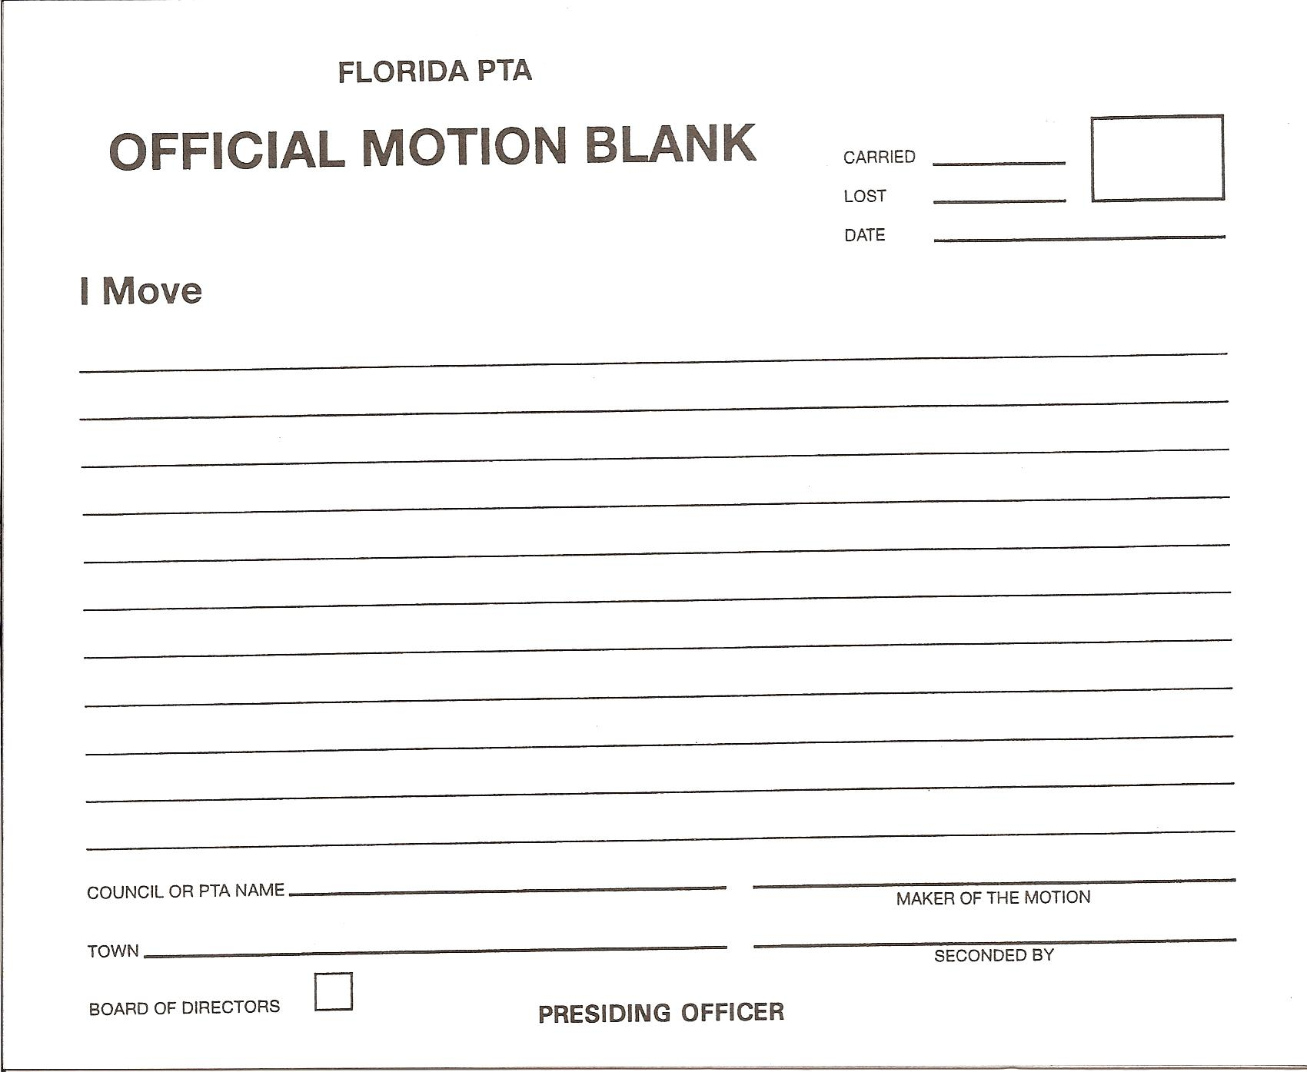
Sample Motion Form:
MOTIONS:
Bring blank motion forms with you to every meeting. Each motion must be written out and the motion and results of the vote are recorded in the minutes.
BALLOTS:
Also be prepared to help count a rising vote and bring blank paper with you for ballots. Results of the vote are recorded in the minutes.

Slide 28
How will you rate?
Board members …
are actively involved in decision-making and planning.
are encouraged to participate in discussion during meetings.
come to meetings prepared and on time.
see themselves as part of a team.
are respectful toward each other.
act as advocates for their PTA.

Slide 29
How will you rate?
Board meetings are …
regularly scheduled and dates planned in advance.
not dominated by one person.
orderly and are completed in a reasonable amount of time.
effective and results-oriented.

Slide 30
Resources
www.pta.org President’s Quick Reference Guide
www.floridapta.org TAB Running Your PTA
www.dccpta.org TAB Resources

Slide 31
Please complete & return your evaluation form
Return your form and be part of the
Gift Card drawing

Slide 32
Your Executive Board: Playing by the Rules
DCCPTA Fall Leadership Workshop September 28, 2014
Mandi Welch and Victor Melone

