Slide 1
Treasurer’s Top Ten Tasks
Duval County Council of PTAs
Jenifer Morgan
Treasurer, DCCPTA
treasurer@dccpta.org

Slide 2
#10 You are not alone. You have resources.
Experience with PTA
Training
Treasurer’s Toolkit
dccpta.org
National PTA “Money Matters”
pta.org
Florida PTA “Dollars and Sense”
Floridapta.org

Slide 3
#9 Dues are important.
State and National dues must be remitted to Florida PTA monthly ($3.50 per member).
Duval County Council dues are due November 1 ($35 per local unit).

Slide 4
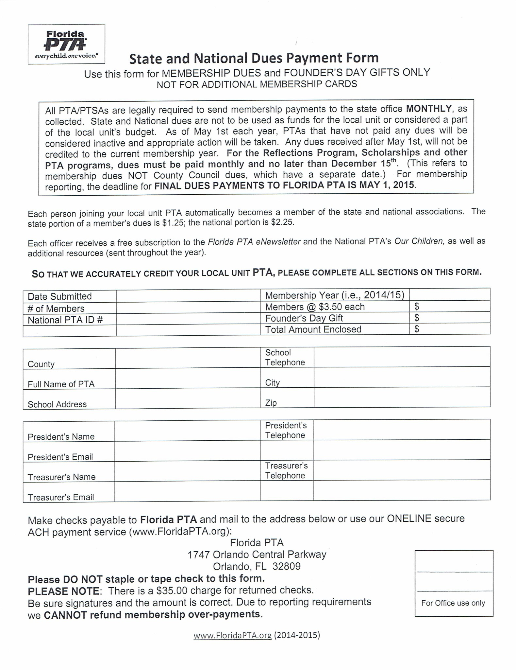

Slide 6
#8 Money In & Money Out: Deposits
Use Deposit Count Form every time you count or collect money.
Two people count the money.
Two people promptly deposit money into PTA’s bank account.
Attach deposit slip to Deposit Count Form.

Slide 8
#8 Money In & Money Out: Checking
Use Check Request Form for every disbursement.
Attach receipts.
Three individuals authorized to sign checks should never be related to each other.
At least two people must sign check.
Pay all bills by check and in a timely manner.
Never sign a blank check or make a check out to cash.
DCC PTA does not recommend the use of debit/check cards for paying expenses.

Slide 10
#8 Money In & Money Out: Electronic Banking
National PTA highly recommends that debit or gift cards not be used as a form of payment. However, deposit only ATM cards are acceptable if your bank offers this service.
Risks of Using Debit/Gift Cards
If lost or stolen, your bank account could essentially be drained before you even realize the card is gone.
When multiple volunteers or employees have access to a debit card, it can be difficult to track the purchases.
Accounting is more difficult to maintain, since individual receipts are the only record of the purchase.
Gift cards are not traceable once purchased.

Slide 11
#7 Budget
A budget is an estimate of money coming in and money going out.
A budget committee develops the budget. The committee should:
Gather suggestions, needs, and probable costs.
Review proposed programs and estimate expenses.
Review past budgets, income and expenses.
Estimate probable income and probable expenses.
Carry-over funds represent the amount which is set aside to begin (and end) operations.
Your budget should be adopted at the first general meeting usually in August or September.
Funds should not be raised nor spent until a budget is approved. After the budget is adopted, it should be followed closely in all financial transactions.
Changes to your budget must be approved by the membership at a general meeting.
Expenditures in your budget must support the PTA mission.

Slide 13
#6 Document Everything
Deposit Count Forms & deposit slips
Check Request Forms & copies of checks
Receipts
Invoices
Returned Checks
Board Meeting Minutes
Correspondence
Bylaws & Standing Rules

Slide 14
#5 Insurance
All PTAs should have some form of insurance.
General Liability - covers routine activities, bodily injury, property damage.
Bonding - protects PTA’s money from theft, if internal controls are in place.
Officers Insurance - protects individual officers of the PTA financially from any personal liability in the event the PTA is sued or cannot pay its bills.

Slide 15
#4 Reporting is Important
Treasurer’s Report
Should be given at each board meeting and general membership meeting.
The report should show:
The PTA’s cash balance
A comparison of PTA income and expenses to budget
The activity that has transpired since the last reporting

Slide 17
#4 Reporting is Important
Outside School Related Organization Monthly Reports must be submitted to the school’s bookkeeper each month.
This is intended to be a reconciliation of your books with the monthly bank statement.
Include all transactions that occurred during the month. (Deposits, checks written during the month, etc. even if they have not cleared the bank.)

Slide 19
#4 Reporting is Important
A financial review/audit is always completed:
At the end of each fiscal year (June 30)
Whenever there is a change in Treasurer’s positions
Anytime the Executive Board requests an additional audit
Financial review/audit must be completed before any checks are written for the new fiscal year.
A financial review/audit is completed by three non-check signers.
Forward a copy to ginger@floridapta.org and treasurer@dccpta.org

Slide 20
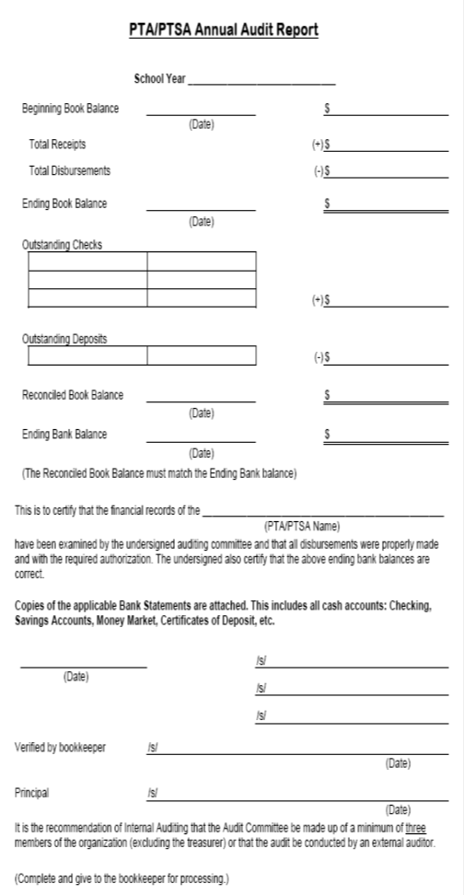

Slide 21
#4 Reporting is Important
A request for fundraising activity form must be submitted and approved by the Principal before any fundraising begins.

Slide 22
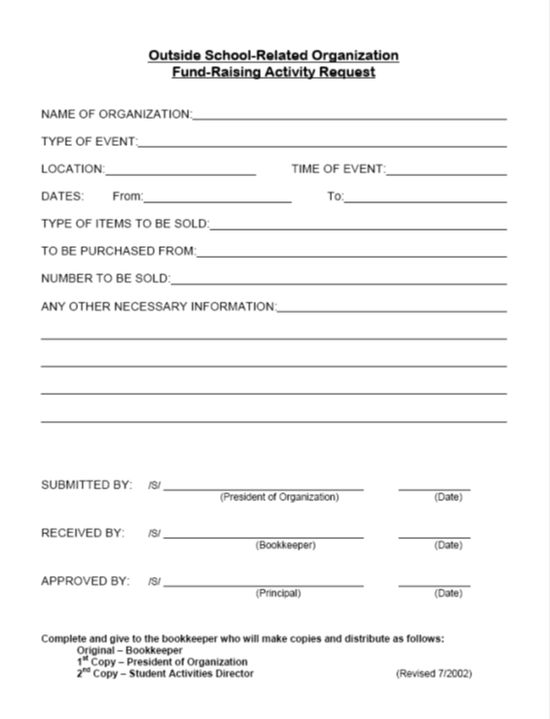

Slide 23
#3 Rules you don’t want to violate (IRS, FLDOR, PTA, District)
IRS:
EVERY UNIT, EVERY YEAR IS REQUIRED TO FILE A TAX RETURN. This must be done well before November 15.
If gross receipts are less than $50,000, then you file a 990-N (takes only 10-15 minutes to complete!).
For gross receipts from $50,000 to $200,000, file Form 990EZ and Schedule A and G.
For gross receipts over $200,000, file Form 990.
Forward a copy to ginger@floridapta.org and treasurer@dccpta.org .

Slide 24
#3 Rules you don’t want to violate (IRS, FLDOR, PTA, District)
Other IRS Rules:
Issue receipts.
Money must not be spent on an individual child; the PTA mission focuses on all children or the school.
PTA cannot engage in political activity.
Be sure to use your PTA’s EIN number on bank accounts and tax returns.
Other IRS Rules: no private benefit, limited lobbying, non-commercial, non-religious, UBI (Unrelated Business Income).
Bottom line follow IRS rules – don’t jeopardize your non-profit tax exempt status.

Slide 25
#3 Rules you don’t want to violate (IRS, FLDOR, PTA, District)
Florida Department of Revenue Sales Tax Rules:
PTAs are not licensed to collect or remit sales tax.
Simply, if you are going to re-sell an item, pay the sales tax to the vendor at the time of the purchase. The vendor must in turn, remit that sales tax to the Florida Department of Revenue.
Always pay vendors with a PTA check.

Slide 26
#3 Rules you don’t want to violate (IRS, FLDOR, PTA, District)
PTA Rules:
Financial Review/Audit at least once a year (June 30)
Approve a budget
Two signatures on checks
Don’t pre-sign checks
No checks made out to cash
Do not pay bills with cash or debit cards
Report and document everything
Dual money count
Remit dues to Florida PTA
Complete and forward tax return (Form 990N, 990EZ or 990) to Florida PTA
Deposit cash right away
Treasurer’s Reports at every meeting
Fraud or missing cash occurs when controls and procedures become sloppy. Don’t let that happen to you.
Duval County Public School District Rules:
The June 30 Financial Review/Audit must be submitted to the school’s bookkeeper.
Outside School Related Organization Monthly Reports must be submitted to the school’s bookkeeper each month.
The request for fundraising activity form must be submitted and approved by the Principal before any fundraising begins.

Slide 27
#2 Soliciting Funds
Membership dues. are a primary source of funding for PTAs.
Fundraising is not a primary function of PTA but can enhance the programs that promote the objectives of PTAs.
PTAs should use the 3 to 1 rule. Plan 3 projects for every 1 fundraiser.
The President signs contracts, as a representative of the PTA not as an individual.
Sponsorships and in-kind donations are also an appropriate means of funding projects.
Issue receipts and/or thank you letters.
PTAs cannot endorse products, companies or foundations.

Slide 28
#1 Be Responsible
A successful Treasurer is accurate, organized, honest, dependable, and consistent.
Be transparent.
The president should work closely with the treasurer.
Ensure the money is spent to support the PTA mission.

Slide 29
Questions
Jenifer Morgan, Treasurer, DCCPTA
treasurer@dccpta.org
Thank you for attending!

