Slide 1
Bonding and Addictions: is there a link?
Richard Marks, PhD, LPC

Slide 2
If you want to go fast, go alone. If you want to go far, go together.
African Proverb

Slide 3
Key Thoughts
Addictions are a form of attachment
Pain pursues pleasure
Addictions medicate pain from broken relationships or a sense of aloneness (lack of social connection)

Slide 4
Definition of Addiction
Definition of an addiction:
An addiction is a pathological love and trust relationship with an object or event (Craig Nakken, The Addictive Personality, Hazelden)
Loneliness: social isolation vs. social connection
The idea of social pain is more than a metaphor. Cacioppo and Patrick in their book, Loneliness, write:
“Fmri shows us that the emotional region of the brain that is activated when we experience rejection is, in fact, the same region – the dorsal anterior cingulate – that registers emotional responses to physical pain.”
When we are bonded or connected to others in healthy social connections we not only feel the connection but we also feel secure.
Feelings of isolation can cause declines in executive control and self-regulation and lead to impulsive and selfish behaviors. The ability to respond actively and purposefully declines, replaced with passivity, negativity, and sometimes even clinical depression.
Thus, when diminished self-regulation integrate with the need to mask our pain with whatever source of pleasure is readily available, we see the propensity for addictions to develop.

Slide 5
“The discovery that feelings of social rejection (isolation) and reactions to physical pain share the same hardware begins to suggest why, once loneliness becomes chronic, you cannot escape it merely by “coming out of your shell, “ losing weight, getting a fashion makeover, or meeting Mr. and Mrs. Right. The pain of loneliness is a deeply disruptive hurt. The disruption, both physiological and behavioral, can turn an unmet need for connection into a chronic condition, and when it does, changing things for the better requires taking into account the full depth and complexity of the role loneliness plays in our biology….”
(Loneliness, page 8)

Slide 6
CA⁵RESS Your Relationship
Love is experienced when our needs are met
Needs met, feel loved. Needs unmet, feel unloved.
Comfort
Acceptance
Affection
Appreciation
Approval
Attention
Respect
Encouragement
Security
Support

Slide 7
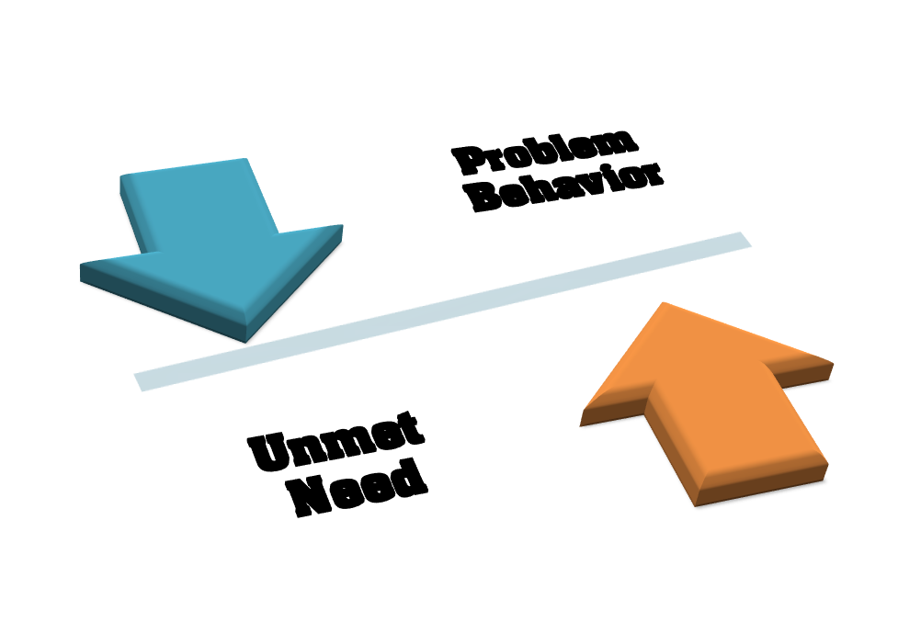
Understanding Fallen and Needy

Slide 8
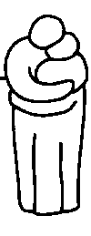
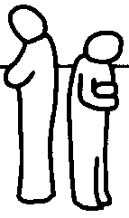
Relationship Roadmap
BIOLOGICALLY BASED NEEDS
FOOD - AIR - WATER - SHELTER
EASE
BONDING
DIS-EASE
EU-STRESS
DISTRESS
TRUST
DISTRUST
HAPPINESS
UNHAPPINESS
PLEASURE
PAIN
DESIRE
DANGER
LOVE
SIGNS OF HAPPINESS
SYMPTOMS OF
FEAR/ANGER
UNHAPPINESS
Health, Energy
Illness, Fatigue
Well Being
Depression
Flexibility
Rigidity of Personality
Creativity
Constriction, Isolation
Open, Sharing
Closed,Guarded,Wary
Personal Responsibility
Anti-Social Behavior
Capacity for Intimacy
Range of Addictions:
Drugs, Alcohol, Food
Thanks to Dr. Lori Gordon of the PAIRS Foundation for the above copyright PAIRS Foundation

Slide 9
“It is an absolute human certainty that no one can know his own beauty or perceive a sense of his own worth until it has been reflected back to him in the mirror of another loving, caring human being.”
John Joseph Powell in The Secret of Staying in Love

Slide 10
CA⁵RESS and Addictions
Four core beliefs of addicts:
I am a bad, unlovable, and unworthy person
No one will love me as I am
I have to meet needs myself
My addiction is my most important need
When needs are not met a person feels pain. We medicate pain through our addictions. A person tries to make sense of why the needs are not met and usually end up thinking:
I am unlovable
I am not worthy
To get my needs met I have to be more, do more, try harder

Slide 11
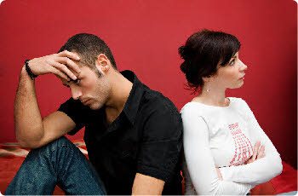
Four Core Relationships
Love God, Self, Others
Shame/Fear Separate US
With God
With family and friends
With community
With yourself

